Slide 1
PINK1 cleavage at position A103 by the mitochondrial protease PARL
Emma Deas, Helene Plun-Favreau, Sonia Gandhi, Howard Desmond, Svend Kjae, Samantha H.Y. Loh, Alan E.M. Renton, Robert J. Harvey, Alexander J. Whitworth, L. Miguel Martins, Andrey Y. Abramov and Nicholas W. Wood
Human Molecular Genetics, 2011, Vol. 20 No. 5, Page 867- 879
Sharif Abu Hayat

Slide 2
FL-PINK1
ΔN-PINK1
ΔN₂-PINK1
PINK 1

Slide 3
Objectives
Determination of the cleavage site of PINK1
Mutational analysis of cleavage site residues
Observation of PD associated mutations
Cellular consequences of impaired PINK1
Identification of the cleavage protease

Slide 4
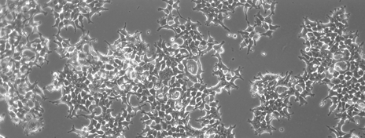
PINK1 Cleavage site determination
Cell Culture
PINK1-3xHA Construct
HEK 293T Cells
Expression
Full-length and cleaved PINK1
Isolation
3x Hemagglutinin (HA) tag
Proteasome inhibitor MG132

Slide 5
PINK1 Cleavage site determination
Characterization
SDS–PAGE
Sequencing
Edman N-terminal degradation
Identification
Cleavage site within the TM domain between residues A103 and F104
Western blot
Coomassie Brilliant Blue Staining

Slide 6
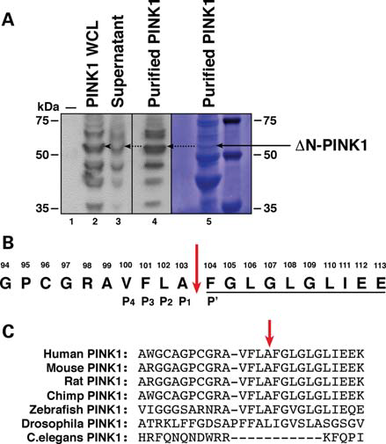
WB analysis
Sequencing result
conservation in mammals

Slide 7
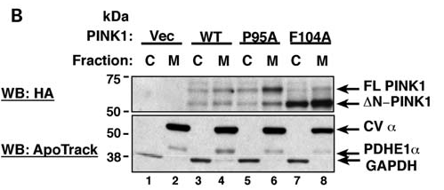
Mutational analysis of cleavage site
F 104 D
FL-PINK1
ΔN-PINK1
P 95 A
FL-PINK1
ΔN-PINK1

Slide 8
Observation of PD associated mutations
FL: ΔN
PINK1
Q115L
C92F
R147H

Slide 9
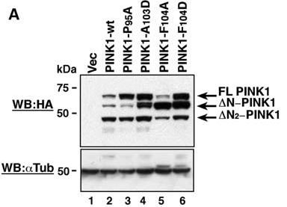

Slide 10
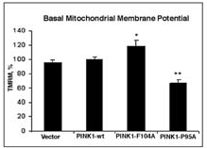
Impaired PINK1: Cellular consequences
TMRM fluorescent intensity measurement
Mitochondrial membrane potential, ΔѰ_{m}

Slide 11
Generation of harmful ROS
Impaired PINK1: Cellular consequences
Cytosolic hydroethidium (HEt) fluorescence
MitoSOX fluorescence

Slide 12
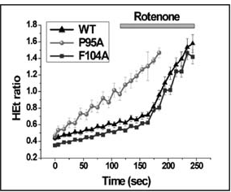
Stimulation of ROS production using rotenone
Impaired PINK1: Cellular consequences

Slide 13
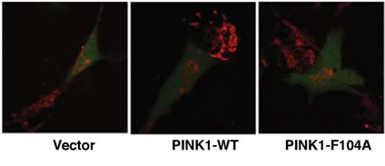
Normal mitochondrial network
Impaired PINK1: Cellular consequences
Cytosolic GFP
Mitochondrial TMRM

Slide 14
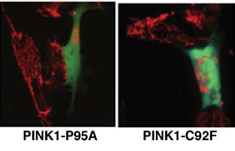
Disrupted mitochondrial network
Impaired PINK1: Cellular consequences
Cytosolic GFP
TMRM

Slide 15
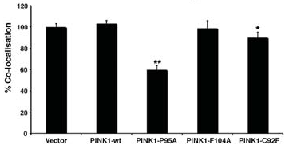
Loss of mitochondrial mass
Impaired PINK1: Cellular consequences
Co-localization of the mitochondrial (DsRed-Mito) signal with the cytosolic (GFP)

Slide 16
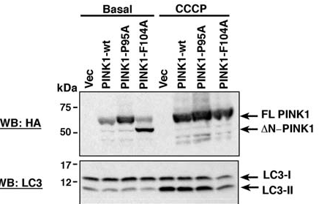
No variation in basal and CCCP-induced levels of LC3 I-II cleavage
Impaired PINK1: Cellular consequences

Slide 17
PARL is the protease responsible for the cleavage of PINK1:
1. High temperature requirement protein A2 (HtrA2)
2. Presenilin-associated rhomboid-like protein (PARL)
MEF Cells
HtrA2 KO
PARL KO

Slide 18
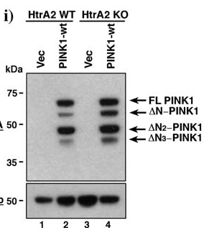
PARL is the protease responsible for the cleavage of PINK1:

Slide 19
PARL is the protease responsible for the cleavage of PINK1:
PARL KO Mouse
PARL-S277G
PARL wt

Slide 20
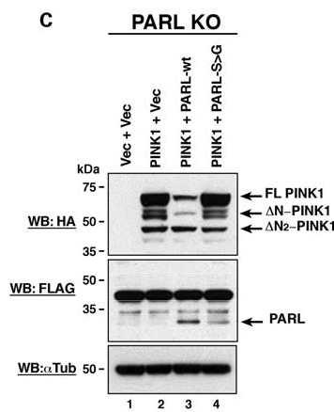

Slide 21
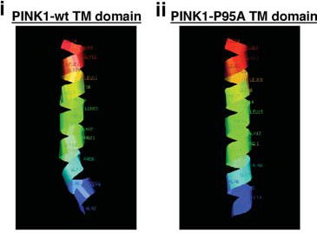

Slide 22
Conclusion
Disruption of distribution of the mitochondrial network
Reduction in mitochondrial mass inside the cell independent of mitophagy activation
Lowering of Mitochondrial membrane potential, ΔѰ_{m}
Increase in generation of harmful ROS
An increased ratio of FL- to ΔN-PINK1, expresses intermediate mitochondrial phenotype

Slide 23
Future Research:
Cleavage recognition site for PARL
ΔN₂-PINK1
Alternative route to LC3 I-II proteasome
Modulated expression of ΔN-PINK1

Slide 24
Thank You!

